Slide 1
Motion Detection and Analysis with Raspberry Pi
Team Member: Zhefeng Lin and Pu Zhang

Slide 2
Problem Statement
In this project, a PIR motion sensor is built to detect motions around the sensor. The occurring time and durations of the motions are then collected by the sensor and read by the raspberry pi. The Pi uses these data for further statistical analysis.
The motion detection sensor system can be widely used in alarming systems, or any queuing systems in service management field, to collect service data, such as service rate and arrival rate. The collected data can be used for further analysis and thus help the operators to make decisions.

Slide 3
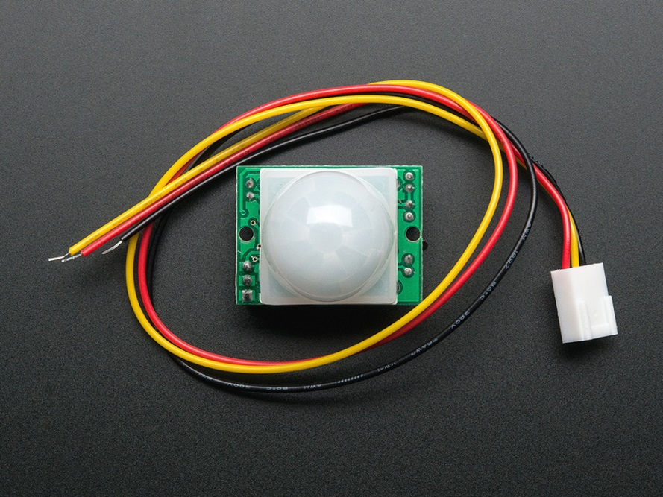
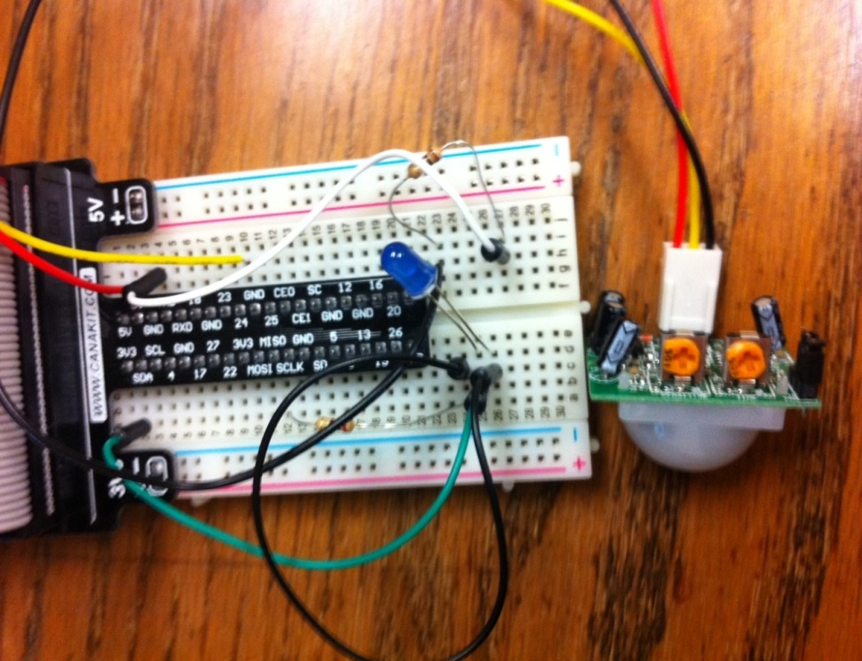
Building up the sensor
In this project, we use an infrared motion sensor and a Raspberry pi to implement our system.

Slide 4
Website (Django) Application
We built the django application using GPIO command to receive signals output by the sensor and then read them by Django and upload all data including statistical analysis to the website.
from django.http import HttpResponse
from sensor.service import *
from django.shortcuts import render
# Create your views here.
def onesec(request):
read_sensor()
read_sensor2()
read_sensor3()
return HttpResponse('')

Slide 5

Data Output
We output the data csv files for further analysis…
The data can be used to study the character of a service system…

